Slide 1



Agenda
SOCIAL BUZZ CONTENT ANALYSIS
Problem Statement
Objective
Process
Dashboard
Insights
Summary
PREPARED BY
LAIBA RANI

Slide 2


Agenda
Problem Statement
Objective
Process
Dashboard
Insights
Summary

Slide 3


Problem Statement
There are over 100 ways that users can react to content, spanning beyond the traditional reactions of likes, dislikes, and comments
Every day over 100,000 pieces of content, ranging from text, images, videos and GIFs are posted. Out of the 250 people working at Social Buzz, 200 of them are technical staff working on maintaining this highly complex technology.

Slide 4
OBJECTIVE
The objective of the Social Buzz Content Analysis Dashboard is to provide a detailed overview of social media content performance and engagement. It aims to identify popular content categories, assess the impact of different content types, monitor trends over time, and summarize key engagement metrics.

Slide 5


Process
1
Data Understanding
2
Data Cleaning
3
Data Modeling
4
Data Analysis
5
Uncover Insights

Slide 6
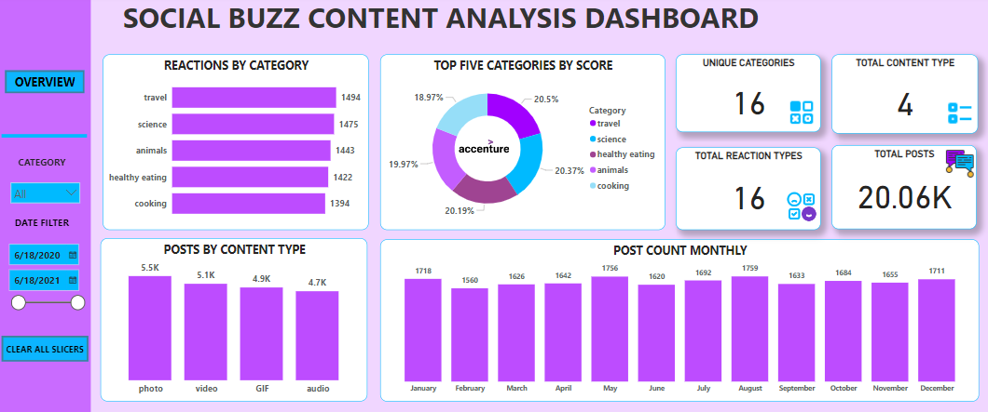

Slide 7

INSIGHTS
The category "Travel" has received 1494 reactions, making it the most engaging category among the ones listed. The "Cooking" category, with 1394 reactions, shows a substantial interest in culinary content.
Photos are the most frequent content type, with 5,500 posts, suggesting they are a preferred medium for sharing. GIFs have 4,900 posts, showing they are a popular format for engaging audiences.
There are 16 unique content categories analyzed in the dashboard, providing a diverse range of topics.

Slide 8
INSIGHTS
Four distinct types of content are identified: photo, video, GIF, and audio, each contributing to the overall engagement. The dashboard tracks 16 different types of reactions, offering a detailed view of audience interactions.
There are a total of 20,060 posts analyzed, providing a comprehensive dataset for understanding content performance.
January saw 1,718 posts, indicating a strong start to the year. November had 1,655 posts, maintaining a steady level. December closed the year with 1,711 posts, matching July's numbers.

Slide 9

Summary
This dashboard provides a comprehensive analysis of social media content, highlighting the engagement by category, the distribution of content types, and monthly posting trends.
The data indicates that the most popular content categories by reactions are travel, science, and animals, with travel leading slightly. Content types are fairly evenly distributed, with photos being the most common, followed by videos, GIFs, and audio.
This analysis can help in understanding audience preferences and optimizing future content strategies.

Slide 10

Thank you!

